Slide 1
Principles of Data Communication [L T P C] is [3 1 0 4]
ICT 2156

Slide 2
Course Outcomes
Apply the concepts of data communication systems to calculate channel capacity.
Analyse different encoding and modulation schemes
Compute frame check sequence and error correction codes.
Analyse flow and error control protocols
Compute the performance of media access protocols

Slide 3
ICT 2156: PRINCIPLES OF DATA COMMUNICATION [3 1 0 4]
Objectives:
To understand basics of data communication
To understand error detection and correction techniques
To understand data link layer protocols
To understand the performance of media access protocols
Abstract:
Introduction to Data Communication, Signals, Basic properties of data communication system, Nyquist rate, Shannon Capacity, Signal encoding and Tx and Rx models, Modulation schemes. Properties of Media and digital transmission systems, wired and wireless medium, Error detection and correction, Block codes, CRC, Hamming code, Stop and wait flow control, Sliding window flow control, ARQs, HDLC, Multiplexing, Media Access Sublayer and LAN, Approaches to sharing transmission medium, Random access protocols, Token passing protocols, IEEE LAN standards, Bridges, MAN, FDDI.

Slide 4
Syllabus:
Data Communication fundamentals: Introduction to Data Communication, Signals, Digital representation of information, Basic properties of data communication system, Time and frequency domain characterization of communication channels, Nyquist signaling rate, Shannon Channel capacity, Line coding-NRZ, bipolar, Manchester, Differential Manchester encoding, Modems and digital modulation- ASK, FSK, PSK, QAM. [14 hours]
Properties of Media and Digital Transmission Systems: Twisted pair, Coaxial cable, Optical fiber, Wireless transmission. [04 hours]
Error detection and correction: Asynchronous and synchronous transmission, Error detection and correction basics, Parity check, Internet checksum, Polynomial codes, Block codes, Hamming code. [08 hours]
Peer to Peer Protocols: Peer to peer protocols and service models, ARQ protocols- Stop and wait, Go back N, selective repeat, Transmission efficiency of ARQ protocols, Other adaptation functions- Sliding window flow control, Timing recovery for synchronous services, Reliable stream service, Data link control- HDLC datalink control, point to point control. Multiplexing-FDM, TDM, STDM. [14 hours]

Slide 5
Media Access sublayer and LAN: Introduction to layered architecture, Protocols, Approaches to sharing transmission Medium, Random Access Protocols, Token Passing protocols, IEEE LAN standards, Bridges, MAN[IEEE802.6], FDDI. [08 hours]
Course Outcome
The students will be able to
Apply the concepts of data communication system to calculate channel capacity.
Analyse different encoding and modultaion schemes.
Compute frame check sequence and error correction codes.
Analyse flow and error control protocols
Compute the performance of media access protocols
References:
1. Stallings W., Data & Computer Communications (9e), Pearson Education Inc., Noida, 2017.
Frozen B., Introduction to data communication & networking (4e), Tata McGraw Hill, New Delhi-2014.
Garcia A. L., Widjaja I., Communication Networks (2e), Tata McGraw Hill, 2011.

Slide 6
What is Data communication?
It is the physical transfer of data over a point to point or point to multipoint communication channel.
Data communications deals with the transmission of signals in a reliable and efficient manner
Networking deals with the technology and architecture of the communications networks used to interconnect communicating devices.

Slide 7
1.1 Trends
Effective and efficient data communication and networking facilities are vital to any enterprise
Three different forces have consistently driven the architecture and evolution of data communications and networking facilities:
traffic growth
development of new services
advances in technology.
Notes:
Traffic Growth: Communication traffic, both local (within a building or building complex) and
long distance, both voice,video and data, has been growing at a high and steady rate for
decades.
development of new Services: As businesses rely more and more on information technology, the range of
services expands.This increases the demand for high-capacity networking and transmission
facilities. In turn, the continuing growth in high-speed network offerings
with the continuing drop in prices encourages the expansion of services.
advances in technology: Advancement in technology enable the provision of increasing traffic capacity
and the support of a wide range of services.

Slide 8
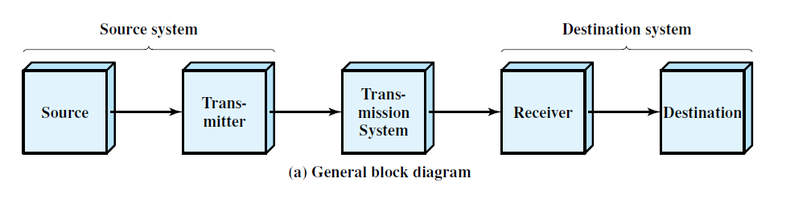
1.2 A COMMUNICATIONS MODEL
a simple model of communications

Slide 9
The key elements of the communications model are as follows:
• Source: This device generates the data to be transmitted; examples are telephones and personal computers.
Transmitter:
the data generated not transmitted directly
a transmitter transforms and encodes the information in such a way as to produce electromagnetic signals that can be transmitted
Transmission system: This can be a single transmission line or a complex network connecting source and destination.
Notes:
Transmitter: the data generated by a source system are not transmitted directly in the form in which they were generated. Rather, a transmitter transforms and encodes the information in such a way as to produce electromagnetic signals that can be transmitted across some sort of transmission system.

Slide 10
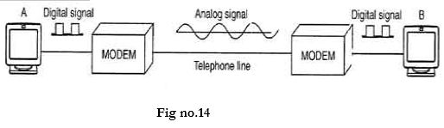
Receiver: The receiver accepts the signal from the transmission system and converts it into a form that can be handled by the destination device.
• Destination: Takes the incoming data from the receiver.
Notes:
Receiver: The receiver accepts the signal from the transmission system and converts it into a form that can be handled by the destination device.
For example, a modem will accept an analog signal coming from a network or transmission line and convert it into a digital bit stream.

Slide 11
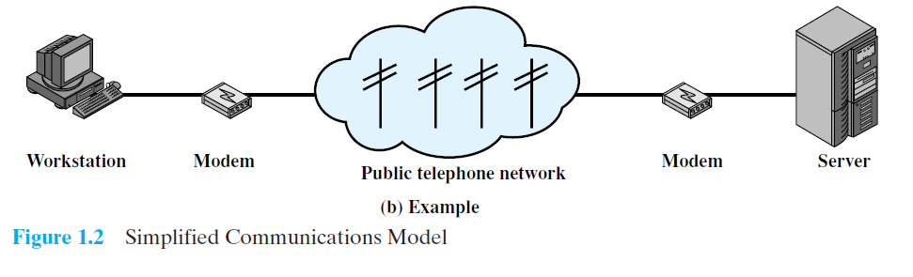
Figure 1.2b presents one particular example, which is communication between a workstation and a server over a public telephone network.
Another example is the exchange of voice signals between two telephones over the same network.

Slide 12
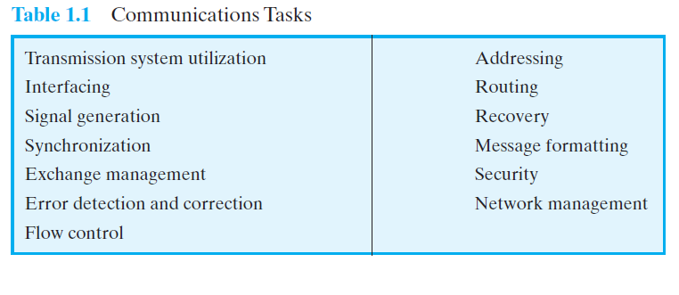
Table 1.1 lists some of the key tasks that must be performed in a data communications system. The list is somewhat arbitrary: Elements could be added; items on the list could be merged;
Notes:
transmission system utilization - need to make efficient use of transmission facilities typically shared among a number of communicating devices
a device must interface with the transmission system
once an interface is established, signal generation is required for communication
there must be synchronization between transmitter and receiver, to determine when a signal begins to arrive and when it ends
there is a variety of requirements for communication between two parties that might be collected under the term exchange management
Error detection and correction are required in circumstances where errors cannot be tolerated
Flow control is required to assure that the source does not overwhelm the destination by sending data faster than they can be processed and absorbed
addressing and routing, so a source system can indicate the identity of the intended destination, and can choose a specific route through this network
Recovery allows an interrupted transaction to resume activity at the point of interruption or to condition prior to the beginning of the exchange
Message formatting has to do with an agreement between two parties as to the form of the data to be exchanged or transmitted
Frequently need to provide some measure of security in a data communications system
Network management capabilities are needed to configure the system, monitor its status, react to failures and overloads, and plan intelligently for future growth
See have gone from the simple idea of data communication between source and destination to a rather formidable list of data communications tasks.

Slide 13

• transmission system utilization - need to make efficient use of transmission facilities typically shared among a number of communicating devices
• a device must interface with the transmission system
• once an interface is established, signal generation is required for communication
• there must be synchronization between transmitter and receiver, to determine when a signal begins to arrive and when it ends
• there is a variety of requirements for communication between two parties that might be collected under the term exchange management
• Error detection and correction are required in circumstances where errors cannot be tolerated

Slide 14

• Flow control is required to assure that the source does not overwhelm the destination by sending data faster than they can be processed and absorbed
• addressing and routing, so a source system can indicate the identity of the intended destination, and can choose a specific route through this network
• Recovery allows an interrupted transaction to resume activity at the point of interruption or to condition prior to the beginning of the exchange
• Message formatting has to do with an agreement between two parties as to the form of the data to be exchanged or transmitted
• Frequently need to provide some measure of security in a data communications system
• Network management capabilities are needed to configure the system, monitor its status, react to failures and overloads, and plan intelligently for future growth

Slide 15
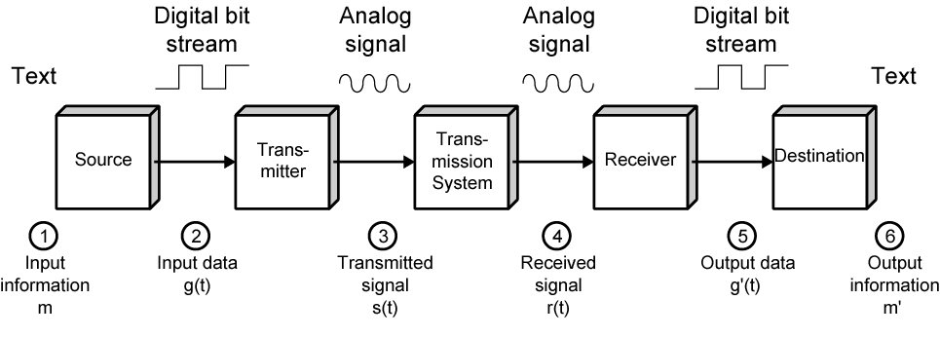
Data Communications Model
Notes:
The process is modeled as follows:
user keys in message m comprising bits g buffered in source PC memory
input data is transferred to I/O device (transmitter) as sequence of bits g(t) using voltage shifts
transmitter converts these into a signal s(t) suitable for transmission media being used
whilst transiting media signal may be impaired so received signal r(t) may differ from s(t)
receiver decodes signal recovering g’(t) as estimate of original g(t)
which is buffered in destination PC memory as bits g’ being the received message m’

Slide 16
Book Referred for this PPT
Stallings W., Data & Computer Communications (9e), Pearson Education Inc., Noida, 2017. Chapter 1.

